Slide 1
Week 8
More complex sql

Slide 2
Table joins
Data is organized in tables
Tables will have a primary key for each item/record that is unique
Joining tables is so that you can get data from two tables
There are different types of joins depending how you want your data presented
The relationship of the tables is based on the primary key and foreign key
Joins are typically done between primary and foreign keys, but can involve other values as well
To have a join, you need a related column otherwise the join won't know how to work.

Slide 3
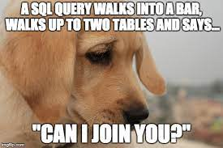
Examples of Table joins
Let's say we have a table of books and a table of library patrons
From what we know about SQL so far we can look at the contents of each table individually and manipulate the data on each single table
Adding in joins allows us to look at combos, such as who borrowed a book or the borrowing history of each patron

Slide 4
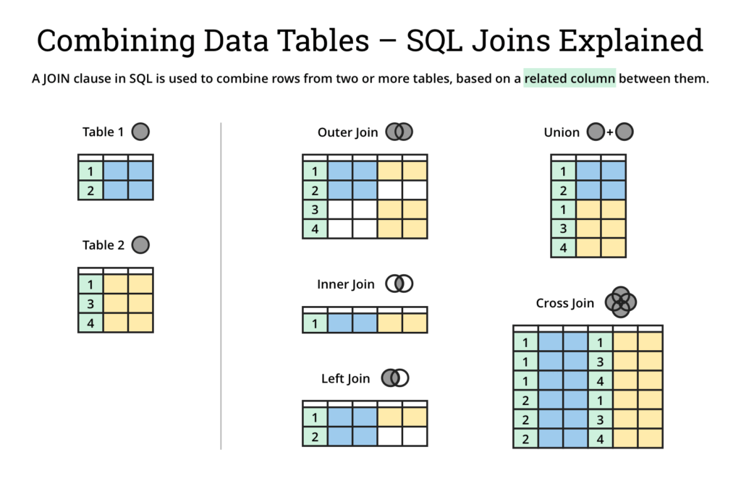
Visual Representation of joins
https://www.atlassian.com/data/sql/sql-join-types-explained-visually

Slide 5
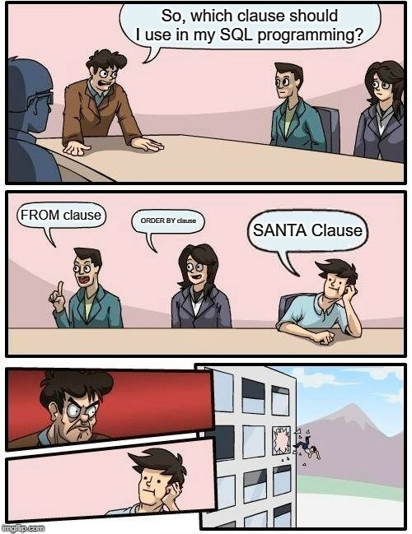
SQL filters
We can also use filters or groupings to get data out of the database
FILTER can show particular pieces of data
One example of filtering data is using the following symbols
Equal =
Not Equal !=
Greater than >
Less than <
For example you could see all books that cost less than $10, or more then $5 or cost equal to $9.99
An example of how this might look in a SQL command would be
SELECT * FROM books_table WHERE price < 10;
SELECT * FROM books_table WHERE price = 9.99;

Slide 6
Adding in multiple options
We can also use AND OR to get multiple options selected
For example, if you wanted to look at books that cost less than $10 AND were published in the last 10 years
An example of how this might look in a SQL command would be
SELECT * FROM books_table WHERE price < 10 AND publish_date > 2015;

Slide 7
SQL distinct
We could also look for items that are unique, or distinct using SQL
This would allow us to look at data without duplication
Example use cases:
If we wanted to make sure we have unique library patrons, we could look for addresses to make sure we are only seeing unique addresses and no duplicates
Looking at books we might want to make sure we are looking at a distinct or unique catalog of books, without duplication so we can take accurate inventory of what we might be missing

Slide 8
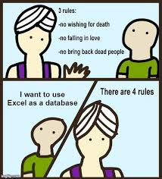
SQL ascending and descending
We can also easily organize our data
Asking the database to give results in any order or organizational pattern we want without changing the data can give us the ability to play with the data in more ways.
SQL has the options of Ascending or Descending
These are denoted by ASC and DESC functions
These are used by saying ORDER BY
In SQL this might look like
SELECT * FROM books_table ORDER BY cost desc;

Slide 9
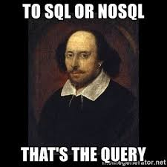
Other functions with SQL
SQL has a number of other functions that are helpful as well
CAUTION: The type of SQL you're using affects what functions there are and how they are labelled.
Some functions are there in all the common dialects of SQL and look the same
https://en.wikibooks.org/wiki/SQL_Dialects_Reference has some examples of what functions look like by dialect
For example, if you wanted to find Natural logarithm of x
Standard SQL says it's LN(x)
MSSQL says it's LOG(x)
MySQL says it can be either one

Slide 10
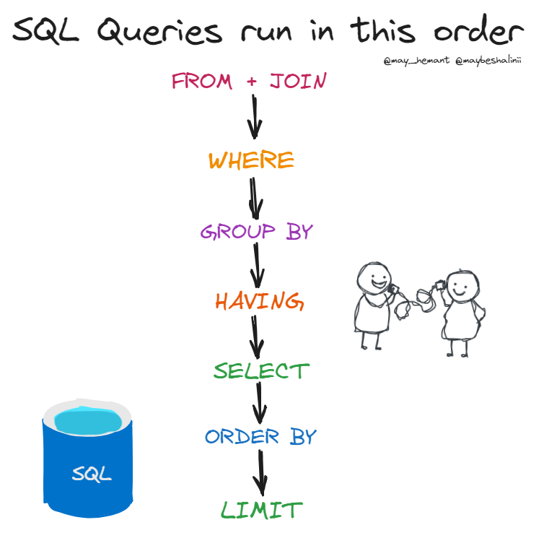
How SQL queries are processed
https://twitter.com/maybeshalinii/status/1728363137903267905

